Slide 1


Slide 2
Introduction:
Conbrio International Music Academy (CIMA) is designed with the objective to make music resources freely as well as conveniently available to those who in need of theory and practical materials.
The site will provide easy access to class enrolment, examination, our orchestra concerts booking as well as live lessons and downloadable pdf materials.
In order to qualify for the as an online pupil, candidates have to undergo a two rounds of interviews by various levels of faculty members.
CIMA holds international competitions twice a year so students are able to perform what they learnt as well as a monthly performance platform is available for them to showcase their performance skills. Students from other countries as well as other academies are also allowed to participate.

Slide 3
Existing system:
So far sites have existed either selling instruments, instructional or competition based but under Conbrio International Music Academy (CIMA) everything is available under one roof.

Slide 4
Proposed system:
The site will make it easy to fulfil all their music craze at one place without the need to go elsewhere.
People will easily be able to show their talent to a wide range of audience
There is easy access to lessons by professions for those are in need of guidance.
Students can strengthen their theory knowledge by the daily online musical quizzes which can be solved online as well as downloadable and solved offline.
Interested people will be able to buy instruments at the online store, tickets for the academy orchestra

Slide 5
Modules
First Module: Academy Course Management
This module consists of 2 sub-function:
Course:
Details of the course are included under this function.
Period,
Cost,
Number of Sessions
Exams:
Examination form can be filled online as well as details of the examination will be available

Slide 6
Second Module: Online Course Management
This module consists of 3 sub-function:
Interview:
All candidate has to undergo 2 rounds of Interview before qualifying for the online course.
Video Submission
Live Video Interview
Teaching:
Live lessons will be available once a week for the enrolled candidates
Exam
At the end of the term all candidates will appear for a live exam as well as an online theory paper.

Slide 7
Third Module: Performance Management
This module consists of 2 sub-function:
Competitions:
Twice a year students can go for various competitions according to their level of ability.
Functionality:
Registration.
Entry Fee.
Live Performance:
Every month the academy holds competitions for their students giving them ample of exposure and stage confidence.

Slide 8
Fourth Module: Online Materials Management
This module consists of 3 sub-function:
Free Materials:
Includes sheets, basic theory, old music scores, instructional videos etc.
Paid Materials:
Books, bands Scores etc.

Slide 9
Search Function:
Navigate throughout the site making all Materials at the user’s fingertips.
Search By Product ID
Search By Name of the product
Search By Company
Search By ISBN Number

Slide 10
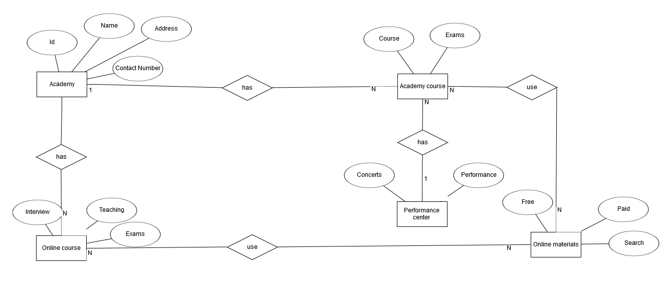
ER Diagram

Slide 11
DFD Context Level
Store
Registration Details
Registration Details
Library
Acknowledgement
Acknowledgement
Browse Product
Plan Details
Display Products
Choose Plan
Add to cart
Browse Product
Display Products
Rent Product
Request Pickup

Slide 12
DFD 1st Level
Academy Course
1.0
Student
Course Details
Personal Details
Student
Personal Details
Student information
Acknowledgement
Examination
Student id
Exams Detail
Exam
Exam Form
Exams Detail

Slide 13
DFD 1st Level
Course Details
Academy
Online Course
2.0
Student
Interview
Student information
Student
Personal Details
Acknowledgement
Student information
Acknowledgement
Examination
Student id
Exam
Exam Details
Exam Form

Slide 14
DFD 1st Level
Concert Details
Performance
3.0
Parents / Audience
Personal Details
Fee Details
Debit/Credit Card Details
Ticket Details
Performance
Performance information

Slide 15
DFD 1st Level
Online Materials
4.0
Student
Product Details
Details of Product
Product information
Product
Requirement Details
Price Details
Debit/Credit Card Details
Billing information
Receipt Details
Billing

Slide 16
Thank You

